Slide 1


Covid Stock Retail Data
Team 7 - Project 1
Cherno Jallow - Lowes
Chris Schultz - Walmart
Wei Kent Chen - Target
Chloe Li - Costco

Slide 2
Project Description
This project attempts to analyze the impact that the COVID-19 pandemic had on the retail stocks
Questions:
How did the stocks perform pre covid? Jan - 2019 to Dec -2019
How did the stocks perform during the pandemic before the vaccine release? Jan-2020 to Nov - 2020
How did the stocks perform during the pandemic after the vaccine release? Dec-2020 to Dec 2021

Slide 3
Solution Approach
Pull retail stock data from yfinance via API
Hypothesis: We assumed that the stock price will go down during the pandemic before the vaccine release

Slide 4
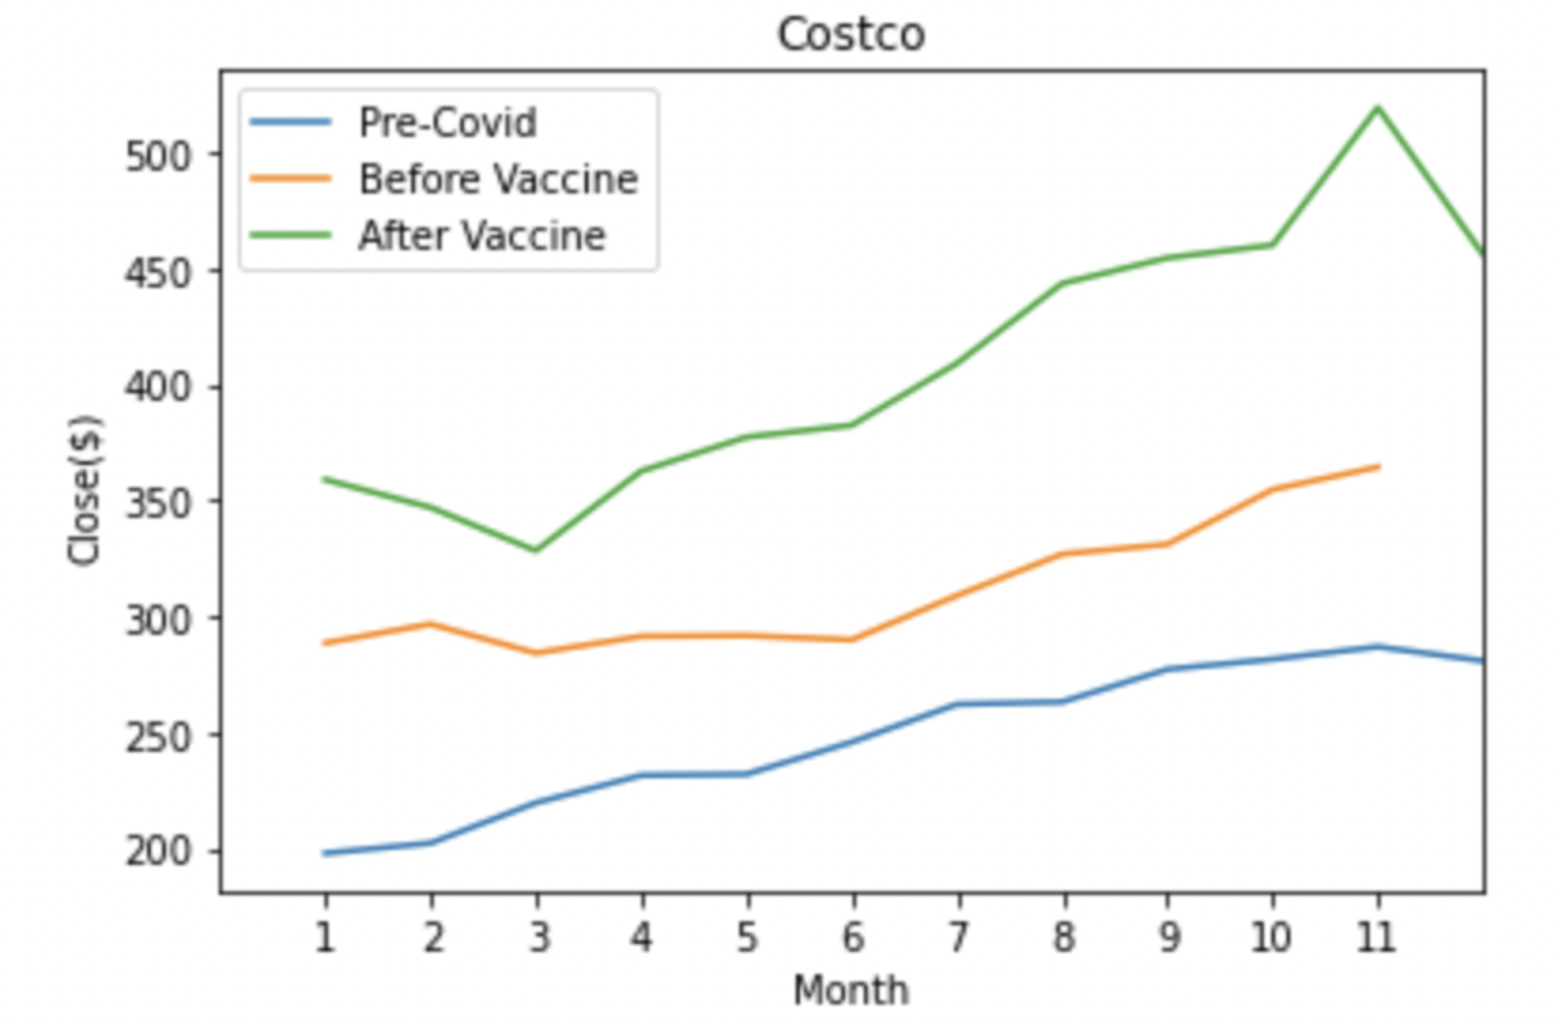
Costco (COST)
Summary of findings
Hypothesis: We assumed that the stock price for Costco will go down during the pandemic before the vaccine release which disproven

Slide 5
Project Description
This project attempts to analyze the impact that the COVID-19 pandemic
Questions:
How did the stocks perform pre covid? Jan - 2019 to Dec -2019
How did the stocks perform during the pandemic before the vaccine release? Jan-2020 to Nov - 2020
How did the stocks perform during the pandemic after the vaccine release? Dec-2020 to Dec 2021

